Slide 1

deadlock
Er. Deeyoranjan Dongol

Slide 2
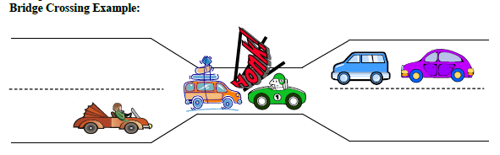
DEADLOCK
A set of blocked processes each holding a resource and waiting to acquire a resource held by another process in the set

Slide 3
RESOURCES
Two Types
Preemptable Resources
- Can be taken away from the process owning it
Non-Preemptable Resources
Cannot be taken away from current owner
Each process utilizes a resources as follows:-
Request
Use
Release

Slide 4
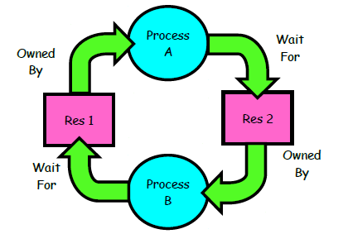
DEADLOCK CHARACTERIZATION
Four conditions for deadlock to occur:-
Mutual Exclusion
Only one process can use the resource at a time
Hold and Wait
Process holding the granted resource and waiting to acquire resources possessed by other process
No Preemption
Process release resource only after completion of task
Circular Wait

Slide 5
DEADLOCK MODELING
Resource Allocation Graph
A directed graph consisting of set of vertices V and a set of edges E
V is partitioned in two different types of nodes
P ={P₁ , P₂ ,…, P_{n} } => Processes
R ={R₁ , R₂ ,…, R_{m} } => Resources
P_{i}→R_{j} signifies that process P_{i} requested an instance of resource type R_{j} and currently waiting for that resource [Request Edge]
R_{j}→P_{i} signifies that an instance of resource type R_{j} has been allocated to process P_{i} [Assignment Edge]

Slide 6
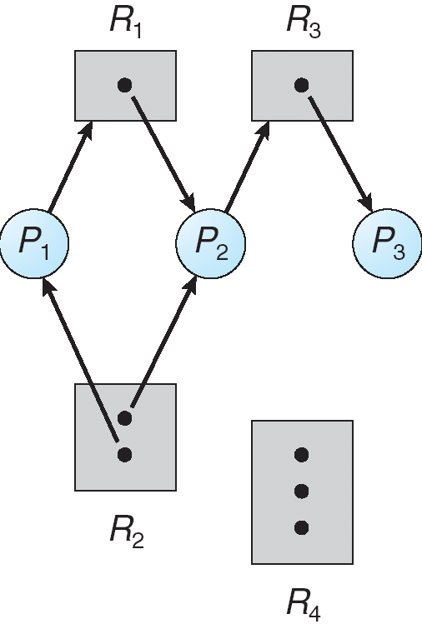
Resource Allocation Graph
Notes:
Note that a request edge points to only the rectangle R1, whereas an assignment edge must also designate one of the dots in the rectangle.

Slide 7
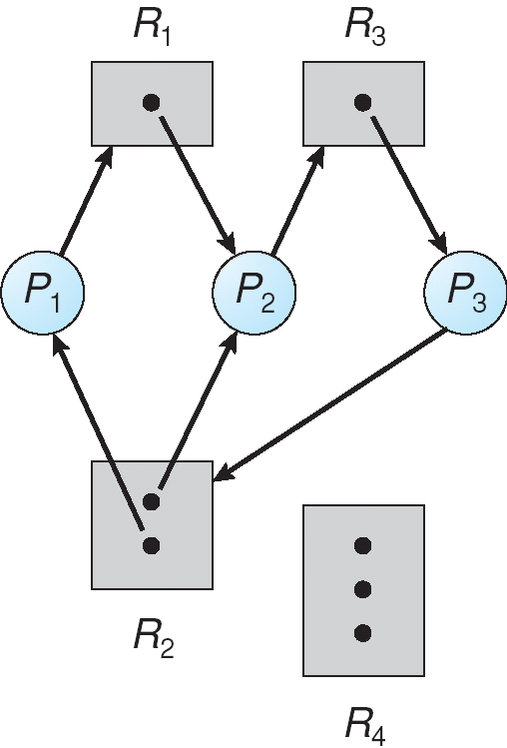
Resource Allocation Graph with Deadlock
Notes:
P1->R1->P2->R3->P3->R2->P1
P2->R3->P3->R2->P2
If graph contains no cycles ⇒ no deadlock.
If graph contains a cycle ⇒
if only one instance per resource type, then deadlock.
if several instances per resource type, possibility of deadlock.

Slide 8
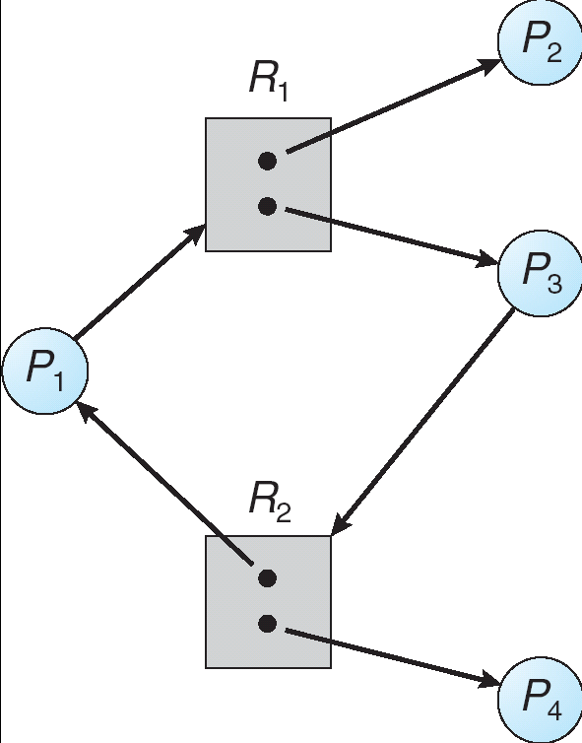
Resource Allocation Graph with Cycle but No
Deadlock
Notes:
P1->R1->P3->R2->P1

Slide 9
METHODS FOR HANDLING DEADLOCK
Ensure that the system will never enter a deadlock state =>Deadlock Prevention
Allow the system to enter deadlock state and then recover=>Deadlock Detection and Recovery
Ignore the problem and pretend that deadlocks never occur in the system =>Deadlock Avoidance

Slide 10
DEADLOCK AVOIDANCE
Requires system to have some additional prior
information available
Process declare the maximum number of resources of each type that it may need
The deadlock avoidance algorithm dynamically examines the resource allocation state to ensure that there can never be a circular wait condition
Resource allocation state is defined by the number of available and allocated resources and the maximum demands of the processes

Slide 11
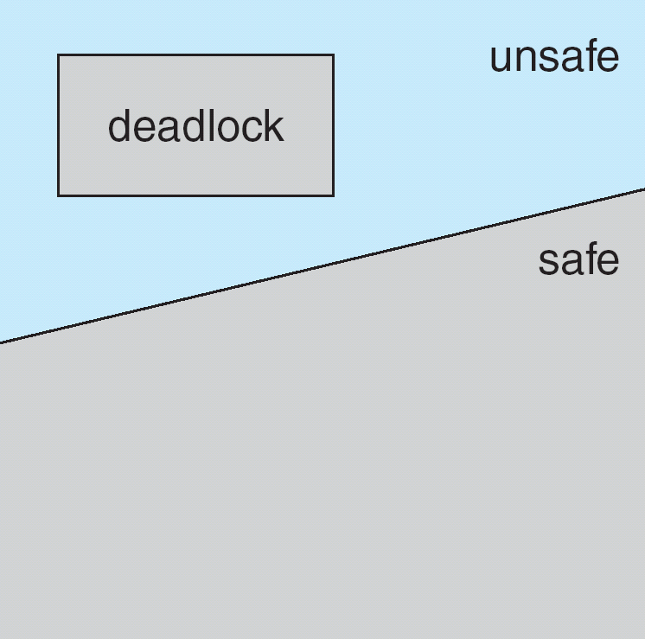
DEADLOCK AVOIDANCE
If a system is in safe state ⇒ no deadlocks
If a system is in unsafe state ⇒ possibility of deadlock
Avoidance ⇒ ensure that a system will never enter an
unsafe state

Slide 12
DEADLOCK AVOIDANCE ALGORITHM
When a process requests an available resource, system must decide if immediate allocation leaves the system in a safe state
System is in safe state, if there exists a sequence <P₁ ,P₂ ,…,P_{n}> of all the processes in the system such that for each process P_{i}, the resource request that P_{i} can still make can be satisfied by currently available resources + resources held by all the P_{j} , with j<i
Banker’s Algorithm
- Single instance of a resource type
- Multiple instances of a resource type

Slide 13
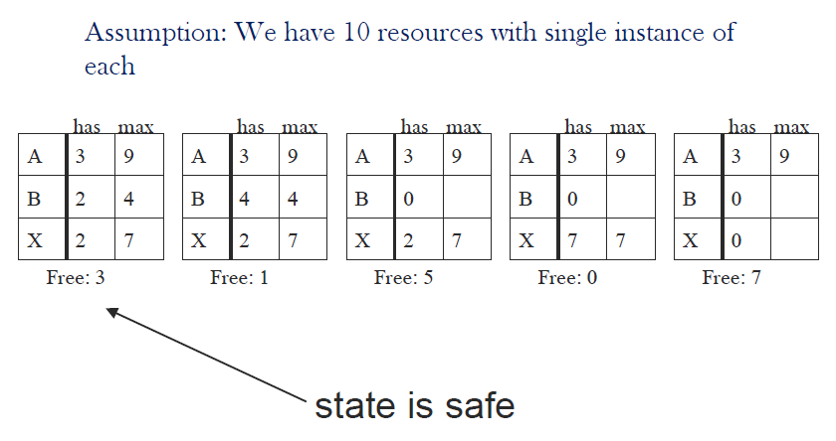
DEADLOCK AVOIDANCE ALGORITHM
Safe and Unsafe state
Notes:
The state of Fig. 3-9(a) is safe because there exists a sequence of allocations that
allows all processes to complete. Namely, the scheduler could simply run B
exclusively, until it asked for and got two more instances of the resource, leading to
the state of Fig. 3-9(b). When B completes, we get the state of Fig. 3-9(c). Then the
scheduler can run X leading eventually to Fig. 3-9(d). When X completes, we get Fig.
3-9(e). Now A can get the six instances of the resource it needs and also complete.
Thus the state of Fig. 3-9(a) is safe because the system, by careful scheduling, can
avoid deadlock.

Slide 14
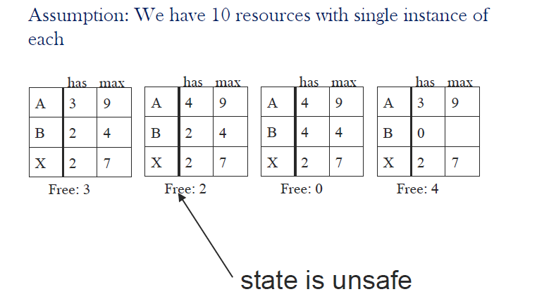
DEADLOCK AVOIDANCE ALGORITHM
Safe and Unsafe state
Notes:
Now suppose we have the initial state shown in Fig. 3-10(a), but this time A requests
and gets another resource, giving Fig. 3-10(b). Can we find a sequence that is
guaranteed to work? Let us try. The scheduler could run B until it asked for all its
resources, as shown in Fig. 3-10(c).
Eventually, B completes and we get the situation of Fig. 3-10(d). At this point we are
stuck. We only have four instances of the resource free, and each of the active
processes needs five. There is no sequence that guarantees completion. Thus the
allocation decision that moved the system from Fig. 3-10(a) to Fig. 3-10(b) went from
a safe state to an unsafe state. Running A or C next starting at Fig. 3-10(b) does not
work either. In retrospect, A’s request should not have been granted.

Slide 15
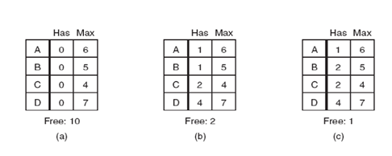

DEADLOCK AVOIDANCE ALGORITHM
Banker’s Algorithm for Single Resource
Notes:
The customers go about their respective businesses, making loan requests from time to
time (i.e., asking for resources). At a certain moment, the situation is as shown in Fig.
3-11(b). This state is safe because with two units left, the banker can delay any
requests except C’s, thus letting C finish and release all four of his resources. With
four units in hand, the banker can let either D or B have the necessary units, and so on.
Consider what would happen if a request from B for one more unit were granted in
Fig. 3-11(b). We would have situation Fig. 3-11(c), which is unsafe. If all the
customers suddenly asked for their maximum loans, the banker could not satisfy any
of them, and we would have a deadlock. An unsafe state does not have to lead to
deadlock, since a customer might not need the entire credit line available, but the
banker cannot count on this behavior.

Slide 16
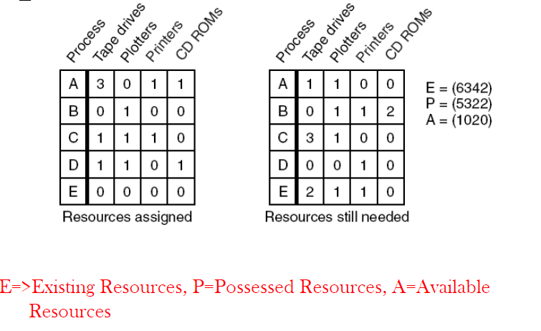
DEADLOCK AVOIDANCE ALGORITHM
Banker’s Algorithm for Multiple Resource

Slide 17
DEADLOCK AVOIDANCE ALGORITHM
Banker’s Algorithm for Multiple Resource
To check whether a state is safe or not
Look for row, R, whose unmet resource needs are all ≤ A. If no such row exists, system will eventually deadlock since no process can run to completion.
Assume process of row chosen requests all resources it needs and finishes. Mark process as terminated, add all its resources to the A vector.
Repeat steps 1 and 2 until either all processes are marked as terminated or until deadlock occurs

Slide 18
DEADLOCK PREVENTION
Ensure that at least one of four conditions required for deadlock can not hold
Attacking Mutual Exclusion Condition
Must hold only for non sharable resources
Attacking Hold and Wait Condition
Ensure that whenever a process requests a resource, it does not hold any other resources
Require process to request and be allocated all its resources before it begins execution or allow process to request resources only when the process has none

Slide 19
DEADLOCK PREVENTION
Attacking No Preemption Condition
If a process holding some resources requests another resource that cannot be immediately allocated to it then all resources currently being held are released
Process restarts only when it regain its old resources along with the new requested resources
Attacking Circular Wait Condition
Impose a total ordering of all resources types, and require that each process requests resources in an increasing order of enumeration

Slide 20
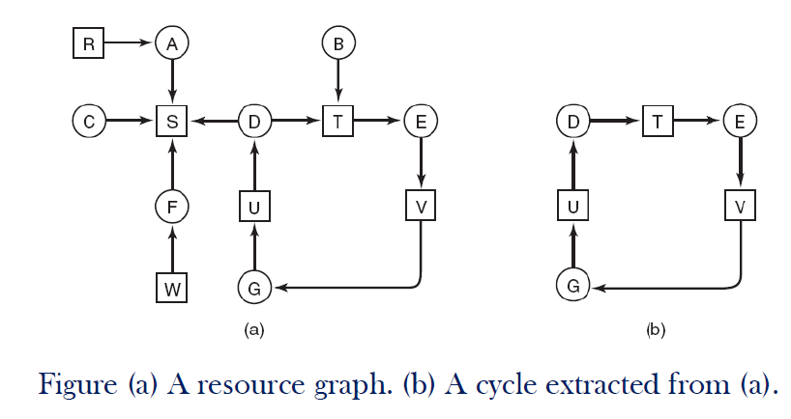
DEADLOCK DETECTION AND RECOVERY
Deadlock Detection With One Resource of Each Type
Notes:
To see how the algorithm works in practice, let us use it on the graph of Fig. 3-5(a).
The order of processing the nodes is arbitrary, so let us just inspect them from left to
right, top to bottom, first running the algorithm starting at R then successively, A, B,
C, S, D, T, E, F, and so forth. If we hit a cycle, the algorithm stops.
We start at R and initialize L to the empty list. Then we add R to the list and move to
the only possibility, A, and add it to L, giving L = [R, A]. From A we go to S, giving L
= [R, A, S]. S has no outgoing arcs, so it is a dead end, forcing us to backtrack to A.
Since A has no unmarked outgoing arcs, we backtrack to R, completing our inspection
of R.
Now we restart the algorithm starting at A, resetting L to the empty list. This search,
too, quickly stops, so we start again at B. From B we continue to follow outgoing arcs
until we get to D, at which time L = [B, T, E, V, G, U, D]. Now we must make a
(random) choice. If we pick S we come to a dead end and backtrack to D. The second
time we pick T and update L to be [D, T, E, V, G, U, D, T], at which point we discover
the cycle and stop the algorithm.

Slide 21
DEADLOCK DETECTION AND RECOVERY
If a system does not employ either a deadlock-prevention or a deadlock-avoidance algorithm then a deadlock situation may occur
In this environment the system must provide
An algorithm that examines the state of the
system to determine whether a deadlock has
occurred
An algorithm to recover from the deadlock

Slide 22
DEADLOCK DETECTION AND RECOVERY
Algorithm for Detecting Deadlock
For each node, N in the graph, perform the following five steps with N as the starting node.
Initialize L to the empty list, designate all arcs as unmarked.
Add current node to end of L, check to see if node now appears in L two times. If it does, graph contains a cycle, algorithm terminates.
From given node, see if any unmarked outgoing arcs. If so, go to step5; if not, go to step 6.
Pick an unmarked outgoing arc at random and mark it. Then follow it to the new current node and go to step 3.

Slide 23
DEADLOCK DETECTION AND RECOVERY
Pick an unmarked outgoing arc at random and mark it. Then follow it to the new current node and go to step 3.
If this is initial node, graph does not contain any cycles, algorithm terminates. Otherwise, dead end. Remove it, go back to previous node, make that one current node, go to step 3.

Slide 24
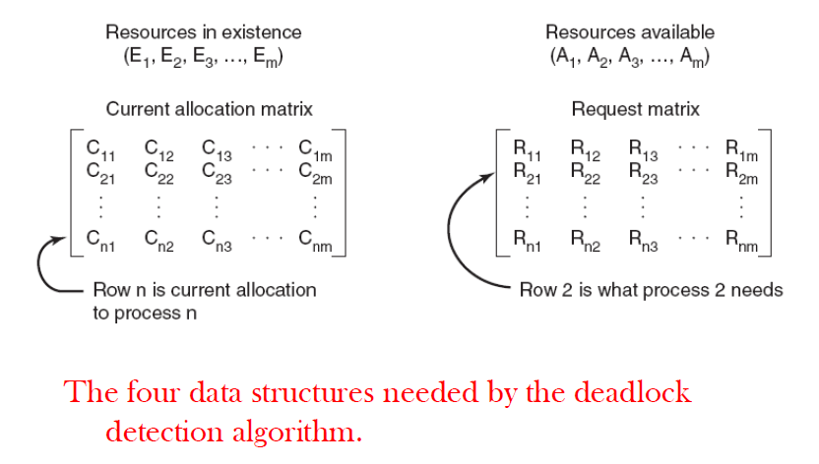
DEADLOCK DETECTION AND RECOVERY
Deadlock Detection With Multiple Resources of Each Type

Slide 25
DEADLOCK DETECTION AND RECOVERY
Algorithm for detecting deadlock
Look for an unmarked process, P_{i} , for which the i-th row of R ≤ A.
If such a process is found, add i-th row of C to A, mark the process and go back to step 1.
If no such process exists, the algorithm terminates.

Slide 26
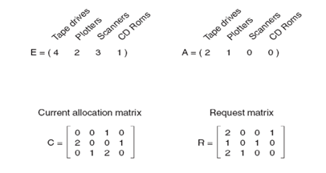
DEADLOCK DETECTION AND RECOVERY
Deadlock Detection With Multiple Resources of Each Type
What happens if process 3 request for 1 CD ROM?
Notes:
To run the deadlock detection algorithm, we look for a process whose resource
request can be satisfied. The first one cannot be satisfied because there is no CD-ROM
drive available. The second cannot be satisfied either, because there is no scanner free.
Fortunately, the third one can be satisfied, so process 3 runs and eventually returns all
its resources, giving
A = (2 2 2 0)
At this point process 2 can run and return its resources, giving
A = (4 2 2 1)
Now the remaining process can run. There is no deadlock in the system.

Slide 27
DEADLOCK DETECTION AND RECOVERY
Deadlock Recovery
Process Termination
Abort all deadlocked processes
Abort one process at a time until deadlock cycle is eliminated
Resource Preemption
Preempt some resources from processes and give these resources to other processes until deadlock cycle is broken
Issues- Selecting a victim, Rollback, Starvation

Slide 28
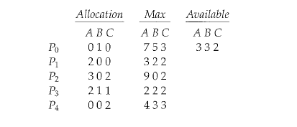
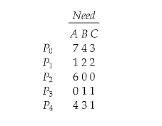

BANKER’S ALGORITHM
Considering a system with five processes P₀ through P₄ and three resources of type A, B, C. Suppose at time t₀ following snapshot of the system has been taken:
How many resources of type A, B and C are present?
What will be the content of Need matrix?
Is the system in a safe state? If yes then what is the safe sequence?
What will happen if process P₁ requests one additional instance of resource type A and two instances of resource type C?
Notes:
For P0, need0=7,4,3
Available = 3,3,2
==> Condition is false, So P0 must wait.
For P1 ,need= 1,2,2
Available=3,3,2
need< Available
So P1 will be kept in safe sequence. & Available will be updated as:
Available= 3,3,2 + 2,0,0 = 5,3,2
For P2, need2= 6,0,0
Available = 5,3,2
==> condition is again false, so P2 also have to wait.
For P3, need3= 0,1,1
Available= 5,3,2
==> condition is true , P3 will be in safe sequence.
Available = 5,3,2 + 2,1,1 = 7,4,3
For P4, need4= 4,3,1
Available = 7,4,3
==> condition Need <= Available is true, so P4 will be in safe sequence
Available = 7,4,3 + 0,0,2 = 7,4,5
Now we have two processes P0 and P2 in waiting state. Either P0 or P2 can be choosen.
Let us take P2 whose need = 6,0,0
Available = 7,4,5
Since condition is true, P2 now comes in safe state leaving the
Available = 7,4,5 + 3,0,2 = 10, 4,7
Next P0 whose need = 7, 4, 3
Available = 10,5,7
since condition is true P0 also can be kept in safe state.
So system is in safe state & the safe sequence is <P1, P3, P4, P2, P0>

